Slide 1
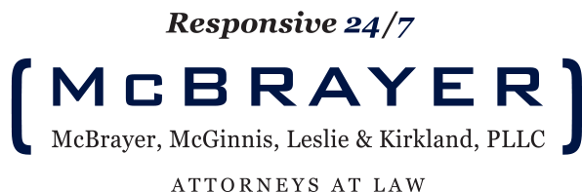

Social Media:
Strategy and Implementation
Are you protected?
Amy D. Cubbage
&
Cynthia L. Effinger

Slide 2
Types of Social Media –
Do You Know Them?
Amy D. Cubbage

Slide 3
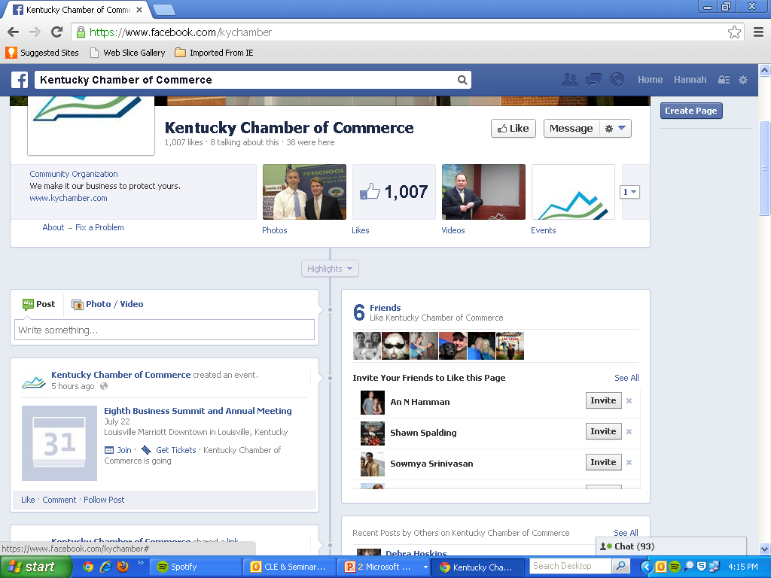

Slide 4
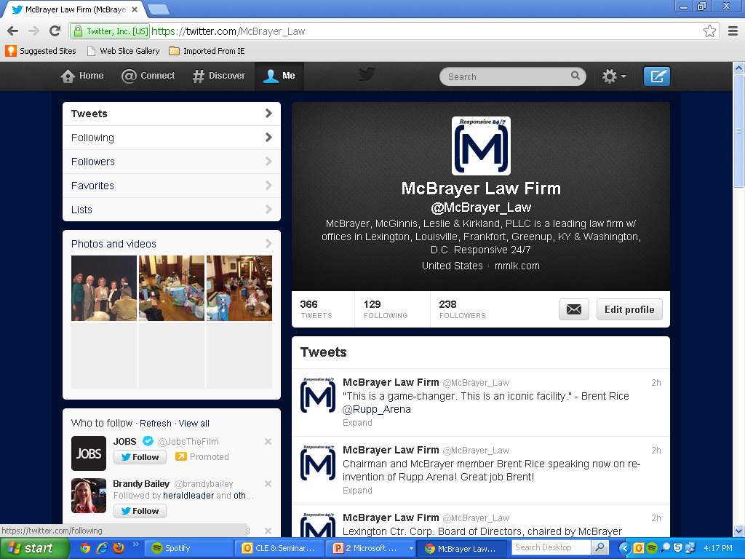

Slide 5
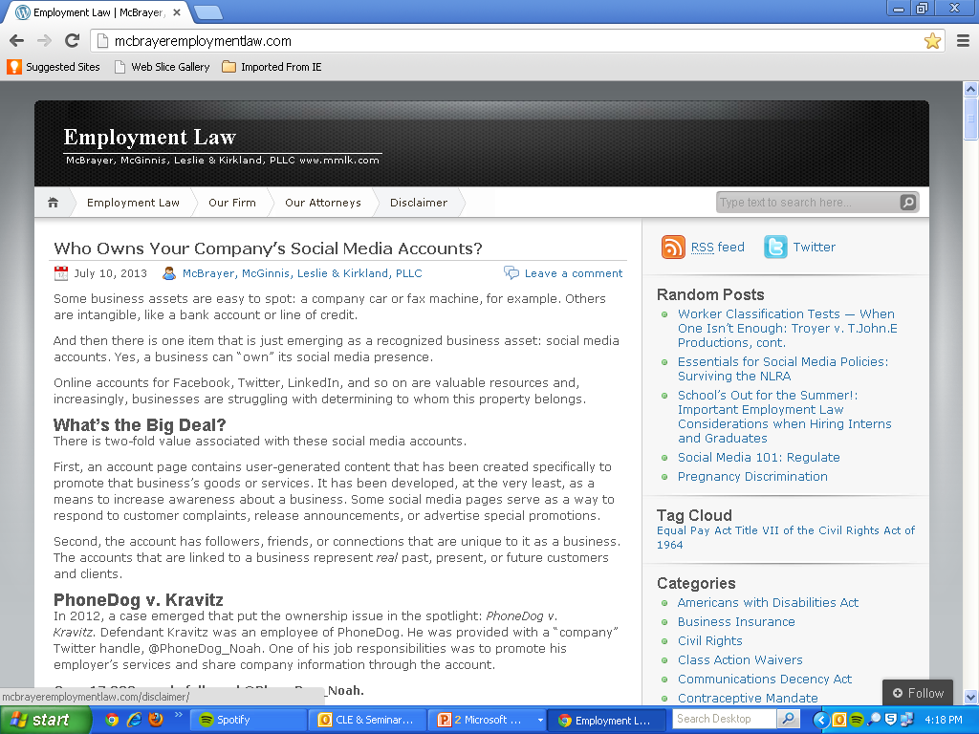

Slide 6
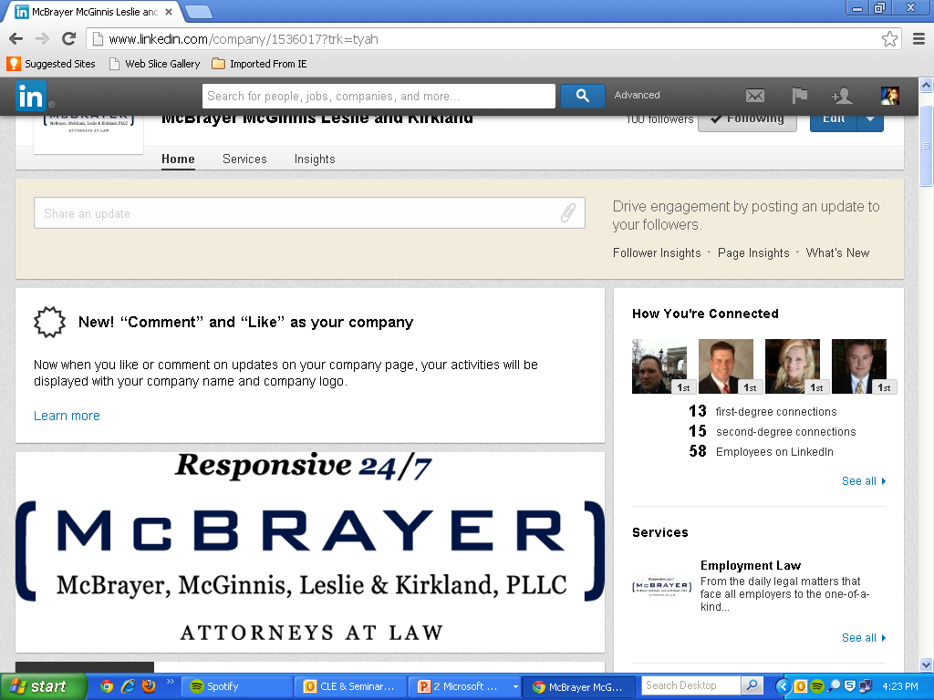

Slide 7
Social Media in Recruiting
Amy D. Cubbage

Slide 8
Use it to:
Get the word out that jobs are available
Screen resumes for accuracy
Screen potential hires to make sure they “fit” your culture (using only publicly available social media)

Slide 9
Watch out for:
SNOPA (Social Networking Online Privacy Act) and PPA (Privacy Protection Act)
Asking for passwords/access to personal accounts of candidates
Making discriminatory decisions based on what you find
Negligent hiring claims

Slide 10
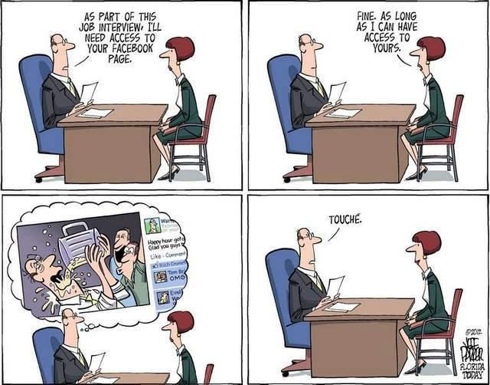

Slide 11

Social Media for Employers:
PR & Advertising

Slide 12
PR & Advertising Concerns
Account for all forms of social media used by your company
Develop a clear, consistent message / marketing strategy
Designate a social media spokesperson
Develop a concise crisis management strategy utilizing social media

Slide 13
Top Things to Consider
Strategy
Executive support (top to bottom)
Staff support and capabilities
Measuring progress (downloads, comments, followers, etc.)
Be willing to experiment

Slide 14
Top Things to Consider
Be patient (no overnight results)
Response time (social networking never stops)
Allocating enough resources and time
The disgruntled customer – do not underestimate him
  See your handout: Old Pro Restaurant Yelp Review

Slide 15





Top Things to Consider
Monitor!

Slide 16
Social Media Ownership

Slide 17
Social Media Ownership
Who “owns” your company’s social media accounts?
They have a 2-fold value: content and connections / follower/ friends

Slide 18
Social Media Ownership
Problems that arise with “ownership”:
Non-compete clause violations (employees taking the accounts / contacts with them when they leave)
Contract breaches (social media terms & conditions employee agreed to)
Conversion (refusal to turn over passwords)
  See your handout: PhoneDog v. Kravitz

Slide 19

Social Media Ownership
See your handout: best practices

Slide 20
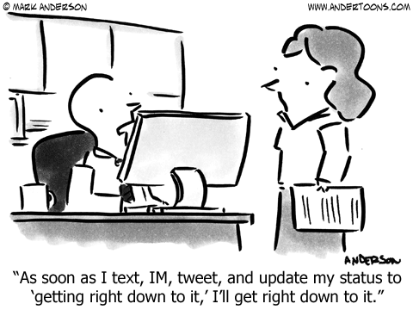
Regulating Social Media Use
Cynthia L. Effinger

Slide 21
Regulating Social Media Use
How many of you have a social media policy at your business?
How many of you have ever had to discipline an employee regarding social media?

Slide 22
Regulating Social Media
Employees on the Job:
Clear, comprehensive social media policy
Give consideration to your intellectual property – protect it
Block sites if necessary for company security & efficiency

Slide 23
Regulating Social Media
Employees off the Job:
Address use off job, but proceed with caution
Address the use of: company name, intellectual property, confidentiality concerns
Enforce policy & follow up on potential violations with legal means

Slide 24



Regulating Social Media
Freedom of Speech concerns
What is “speech”?

Slide 25
Regulating Social Media
PUBLIC EMPLOYERS (teachers, police, etc.) | PRIVATE EMPLOYERS
Protected by 1st amendment | No constitutional duty, but subject to NLRB & state law
Right to speak on matters of “public concern & interest”, but balanced against employer’s right to avoid disruption & efficiency | NLRA allows for employees to communicate in “concerted manner” w/ respect to “terms & conditions” of employment
Speech made pursuant to official duties is not protected; not acting as a citizen | Can have discussions for the employees’ “mutual aid”

Slide 26
Regulating Social Media
See your handouts: real world examples and best practices

Slide 27

Social Media Defamation

Slide 28
Social Media Defamation
Defamation is a false statement, communicated to others, that causes injury to a person, group, or entity (such as a business).
Not: the truth, a person’s opinion, or general reporting.

Slide 29
Social Media Defamation
How many of you have found negative statements about your business online?
2) What have you done about it?

Slide 30
Social Media Defamation
Kentucky is a defamation per se state, meaning injury to reputation is presumed in certain cases.
attributing to someone a criminal offense;
a loathsome disease;
conduct incompatible with his business, trade, profession, or office;
serious sexual misconduct.
Restatement (Second) of Torts § 570 (1977).

Slide 31
Social Media Defamation
PUBLIC FIGURE (politicians) | PRIVATE FIGURE
Actual malice | Negligence & disregard for the truth

Slide 32
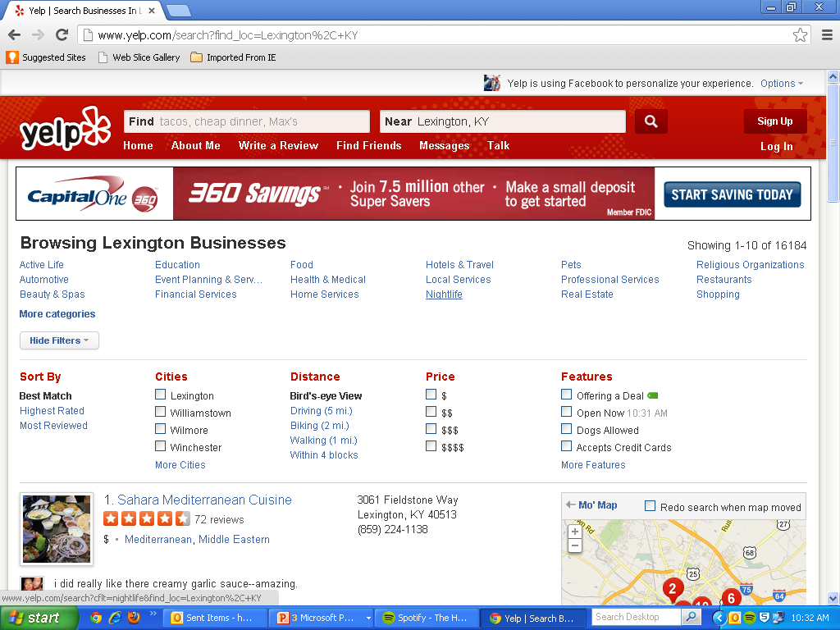
Social Media Defamation
Some social media sites are quick to pull defamatory content, others are not.

Slide 33
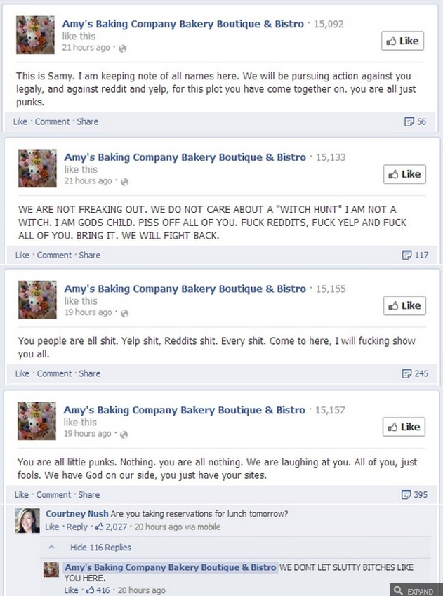
How to not handle a social media crisis:
See your handout: best practices

Slide 34
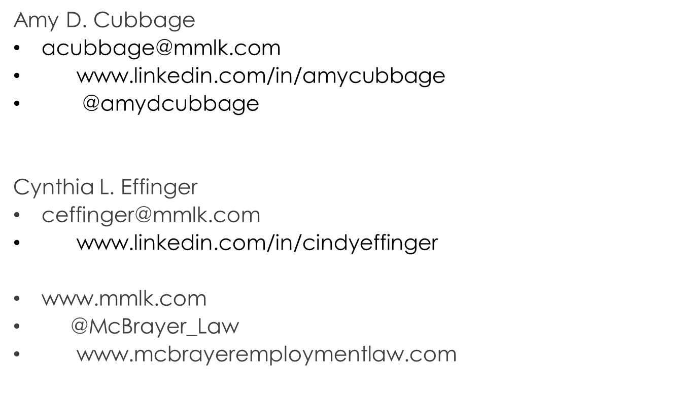



Contact Information

